Slide 1
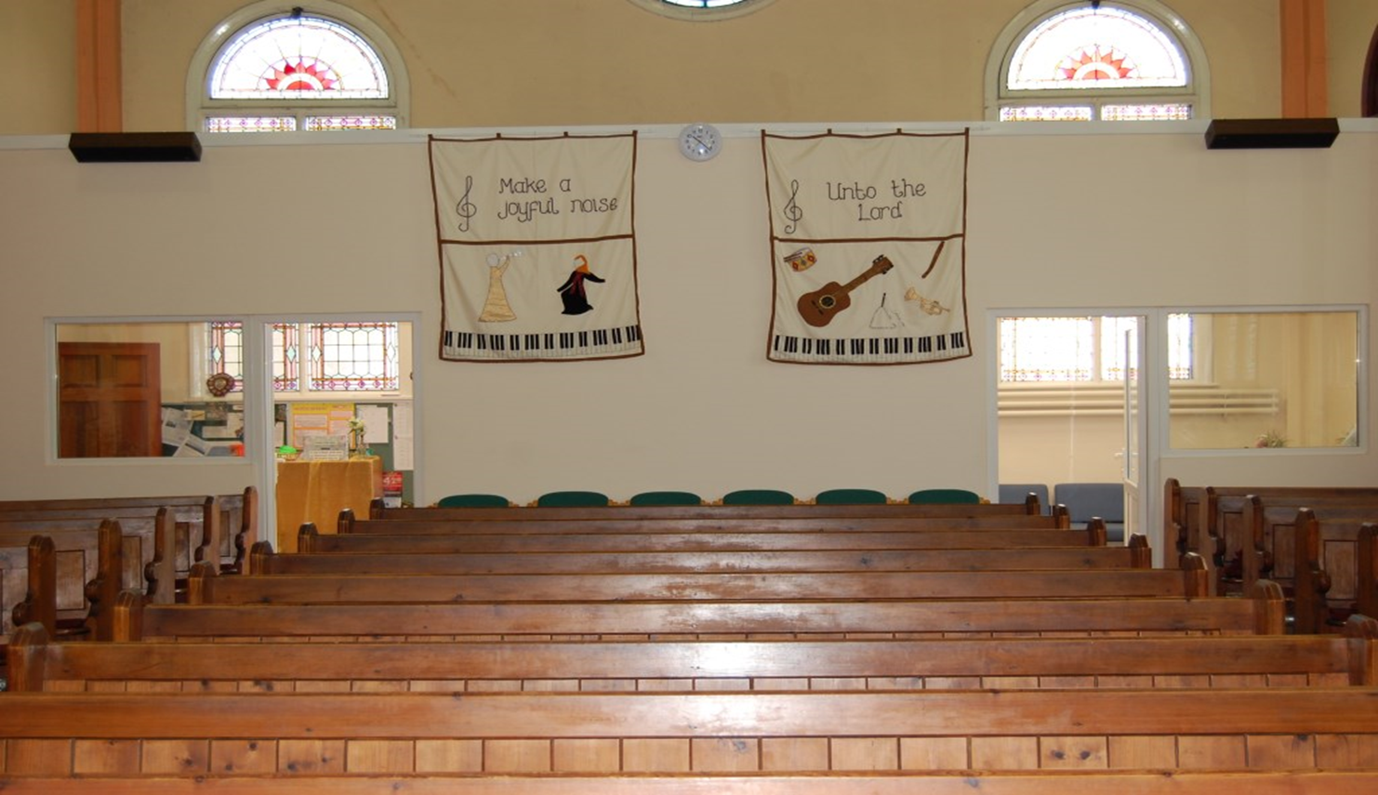
Barnabas
WELCOME TO WORSHIP

Slide 2
Psalm 24: 1 - 6
Barnabas
July 20th
WELCOME TO WORSHIP

Slide 3
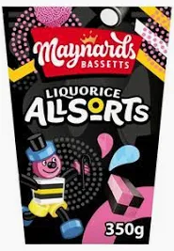
Barnabas
God’s encourager
Liquorice Allsorts

Slide 4
Acts 4: 31- 36;
Barnabas
God’s encourager
36Joseph, a Levite from Cyprus, whom the apostles called Barnabas (which means “son of encouragement”), 37 sold a field he owned and brought the money and put it at the apostles’ feet.

Slide 5
Acts 4: 31- 36; 9: 19b -31;11: 19 -26
Barnabas
God’s encourager
His background - Levite from Cyprus
His nickname - Sunshine man
His generosity - Selling and releasing
His relationship - Mark’s Cousin (Col 4:10)

Slide 6
Acts 11: 19 -26
Barnabas
God’s encourager
11:24 He was a good man, full of the Holy Spirit and faith, and a great number of people were brought to the Lord.

Slide 7
Acts 4: 31- 36; 9: 19b -31;11: 19 -26
Barnabas
God’s encourager
His qualities – good, full of Holy Spirit, faith
His discernment- saw what the grace of God had done
His response – glad, encouraged them

Slide 8
Acts 9: 19b -31;11: 19 -26
Barnabas
God’s encourager
11: 25 Then Barnabas went to Tarsus to look for Saul, and when he found him,he brought him to Antioch…
9: 27 But Barnabas took Saul and brought him to the Apostles

Slide 9
Acts 4: 31- 36; 9: 19b -3131;11: 19 -26
Barnabas
God’s encourager
Barnabas – overcame fear and distrust
Barnabas – told Saul’s story to the apostles
Barnabas – became a gateway for Saul’s ministry

Slide 10
Acts 4: 31- 36; 9: 19b -31;11: 19 -26
Barnabas
God’s encourager
HOW TO BECOME AN ENCOURAGER!
Give the most
Believe the best
Serve the church
Take risks for God
Keep God at the centre of your feelings, thoughts, decisions and actions.

Slide 11
Acts 4: 31- 36; 9: 19b -31;11: 19 -26
Barnabas
God’s encourager

